Slide 1
Privacy-preserving methods: Building secure projects

Slide 2

Rebeca Sarai 👩‍💻
Recife, Brazil ☀️ 🌊 🏖️ 🏝️ 🇧🇷
Computer Engineering by University of Pernambuco 👩‍🎓
Football fan ⚽
Software Engineer
@_rebecasarai

Slide 3


We're a team of experts from Brazil.
We help our clients evolve their products the right way
with top notch development and UX techniques.
Get to know us: vintasoftware.com

Slide 4
Security and Privacy

Slide 5
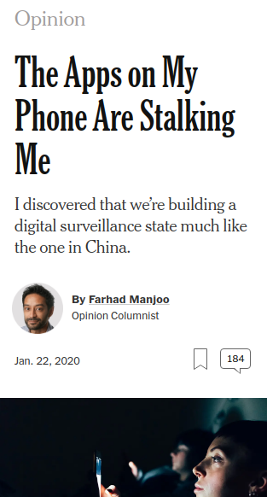
Scientists don't have enough data to build new models
We don't feel safe
Notes:
https://www.nytimes.com/2020/01/22/opinion/phone-data-privacy.html

Slide 6
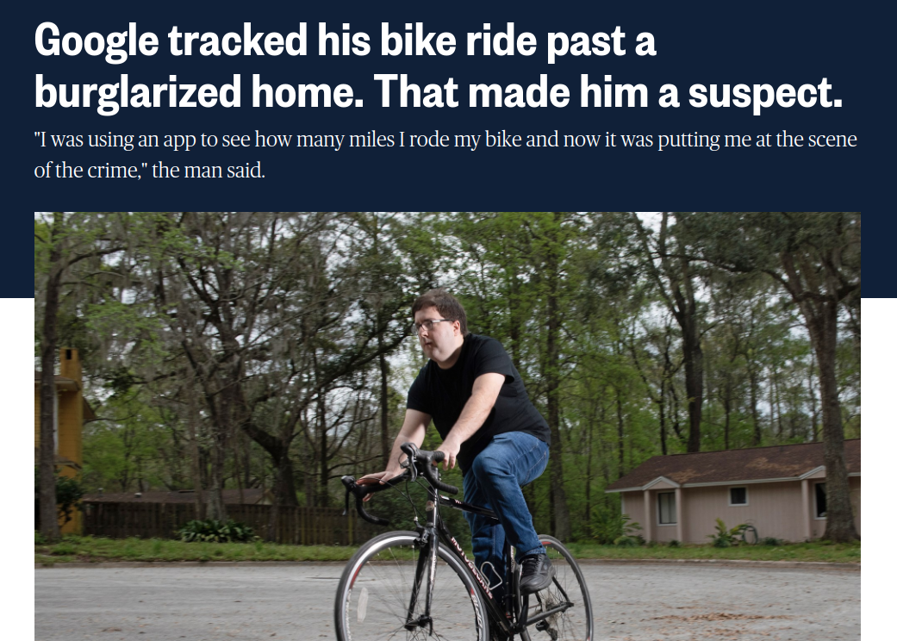
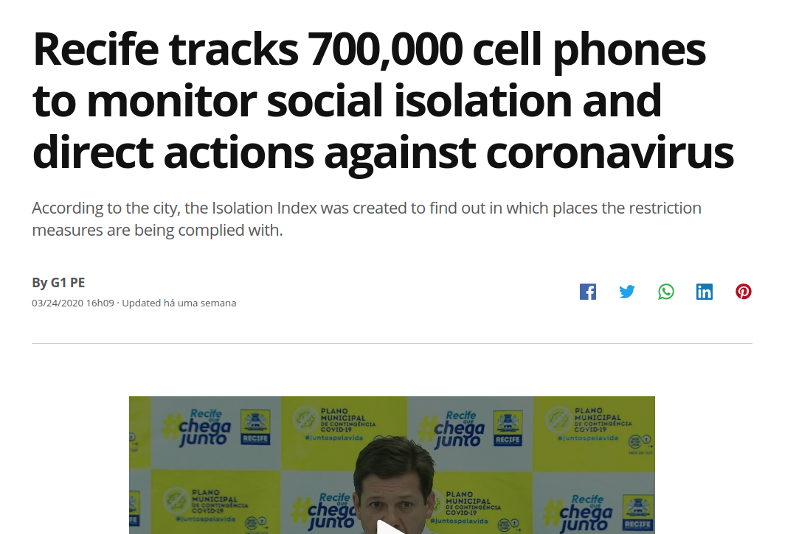
Notes:
https://www.nbcnews.com/news/us-news/google-tracked-his-bike-ride-past-burglarized-home-made-him-n1151761
https://g1.globo.com/pe/pernambuco/noticia/2020/03/24/recife-rastreia-700-mil-celulares-para-monitorar-isolamento-social-e-direcionar-acoes-contra-coronavirus.ghtml

Slide 7
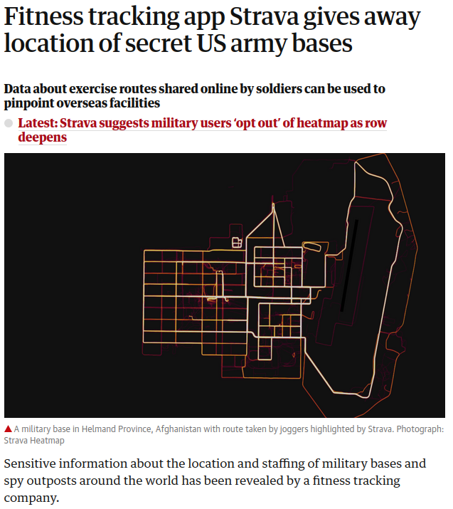
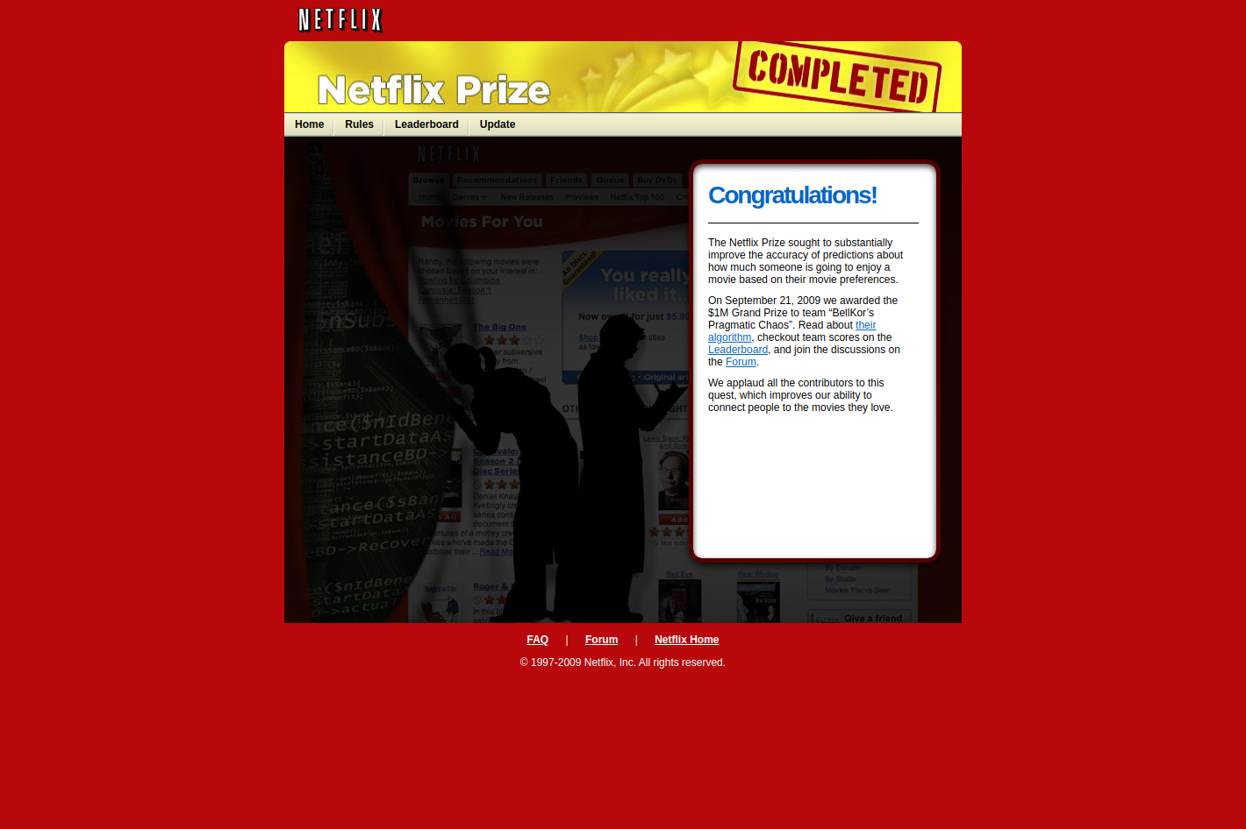
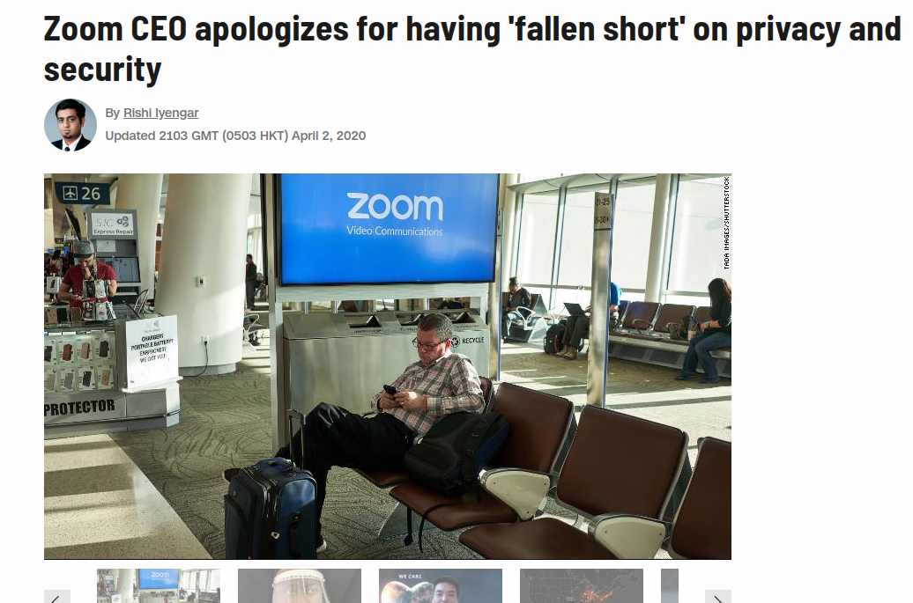
Notes:
https://www.theguardian.com/world/2018/jan/28/fitness-tracking-app-gives-away-location-of-secret-us-army-bases
https://www.netflixprize.com/
https://edition.cnn.com/2020/04/02/tech/zoom-ceo-apology-privacy/index.html

Slide 8
You want to collect and release data that contains answers to sensitive questions

Slide 9





You want to collect and release data that contains answers to sensitive questions

Slide 10
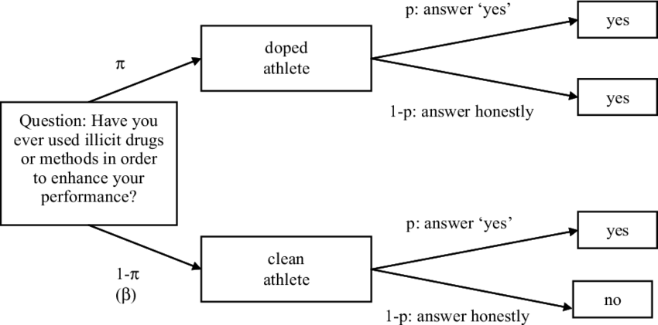


Slide 12
“How many people in the database have used illicit drugs?”
“How many people, not named Jane, in the database used illicit drugs?”

Slide 13
Summary Statistics are Not “Safe”
Differencing attacks
Reconstruction attacks
Each individual has a “secret bit”

Slide 14
You want to collect and release data that contains answers to sensitive questions

Slide 15
Randomization
1965
Plausible deniability (coin flip mechanism)
Good if you have many examples
Allow the recovering of the underlying statistics

Slide 19


You want to make generalizations over a population

Slide 20
Queries Over Large Sets are Not Protective
“How many people in the database have the sickle cell trait?”
“How many people, not named Jane, in the database have the sickle cell trait?”

Slide 21
Queries Over Large Sets are Not Protective
“How many people in the database have the sickle cell trait?”
“How many people, not named Jane, in the database have the sickle cell trait?”
Differencing attack

Slide 22
The state or condition of being free from being observed or disturbed by other people.

Slide 23
The state or condition of being free from being observed or disturbed by other people.
Privacy is preserved if... after the analysis, the analyzer doesn't know anything about the people in the dataset. They remain "unobserved".

Slide 24
The state or condition of being free from being observed or disturbed by other people.
Privacy is preserved if... after the analysis, the analyzer doesn't know anything about the people in the dataset. They remain "unobserved".
Anything that can be learned about a participant from the statistical database can be learned without access to the database

Slide 25
Agreement between a data holder and a data subject: The owner of the data will not be affected, adversely or otherwise, by allowing your data to be used in any study or analysis, no matter what other studies, datasets, or information sources are available

Slide 26
Differential Privacy
2006
Teachings Database != Actions of individual people
It’s a formal definition of privacy
Requires a form of randomness or noise added to the query to protect from Differencing Attacks

Slide 27




In the context of a database:
Given we perform some query on the database, if we remove a person from the database and the query does not change then that person's privacy is fully protected

Slide 28
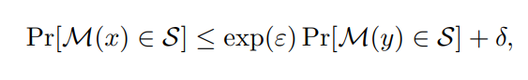
e raised to the epsilon power
ℳ is a randomized mechanism that gives ε-differential privacy for all data sets

Slide 29
Differential Privacy
Budget ε = 0.1
Measure of privacy loss ε (privacy budget)
Tune the "amount of privacy"
Privacy-preserving data analysis
Many open source implementations
https://github.com/google/differential-privacy
https://github.com/uber-archive/sql-differential-privacy
https://github.com/google/rappor
https://github.com/prashmohan/GUPT
https://github.com/LLGemini/PINQ
https://github.com/ektelo/ektelo
Query with ε1 = 0.02
Query #1 with ε1 = 0.02
Multiple queries
Notes:
https://github.com/google/rappor
https://github.com/prashmohan/GUPT
https://github.com/LLGemini/PINQ
https://github.com/ektelo/ektelo

Slide 30
You want to collect and release data that contains answers to sensitive questions

Slide 31
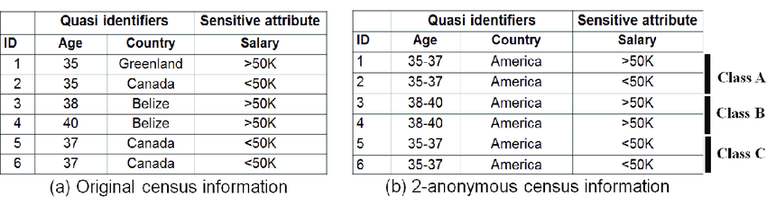

Slide 32
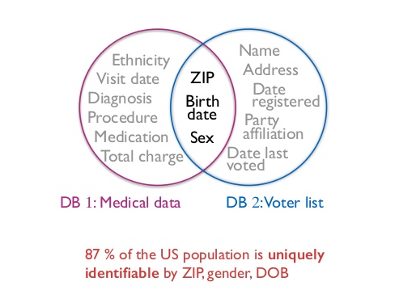

Slide 33
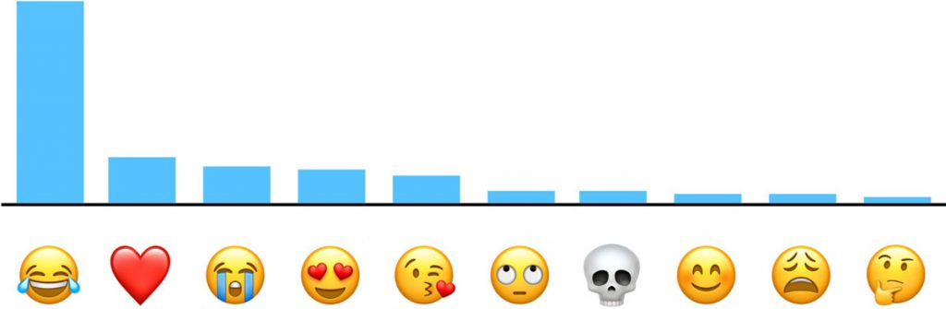
The Mac Observer

Slide 34

k-Anonymity
Creates groups with at least k records sharing the same quasi-identifiers values.
Generalization and Suppression
Provides protection against identity disclosure

Slide 35
k-Anonymity
Linkage attack: Netflix subscribers issue
Refinements of the k-Anonymity (l-diversity, t-closeness, ß-likeness)
Data Cannot be Fully Anonymized and Remain Useful.
Privacy vs Utility

Slide 36
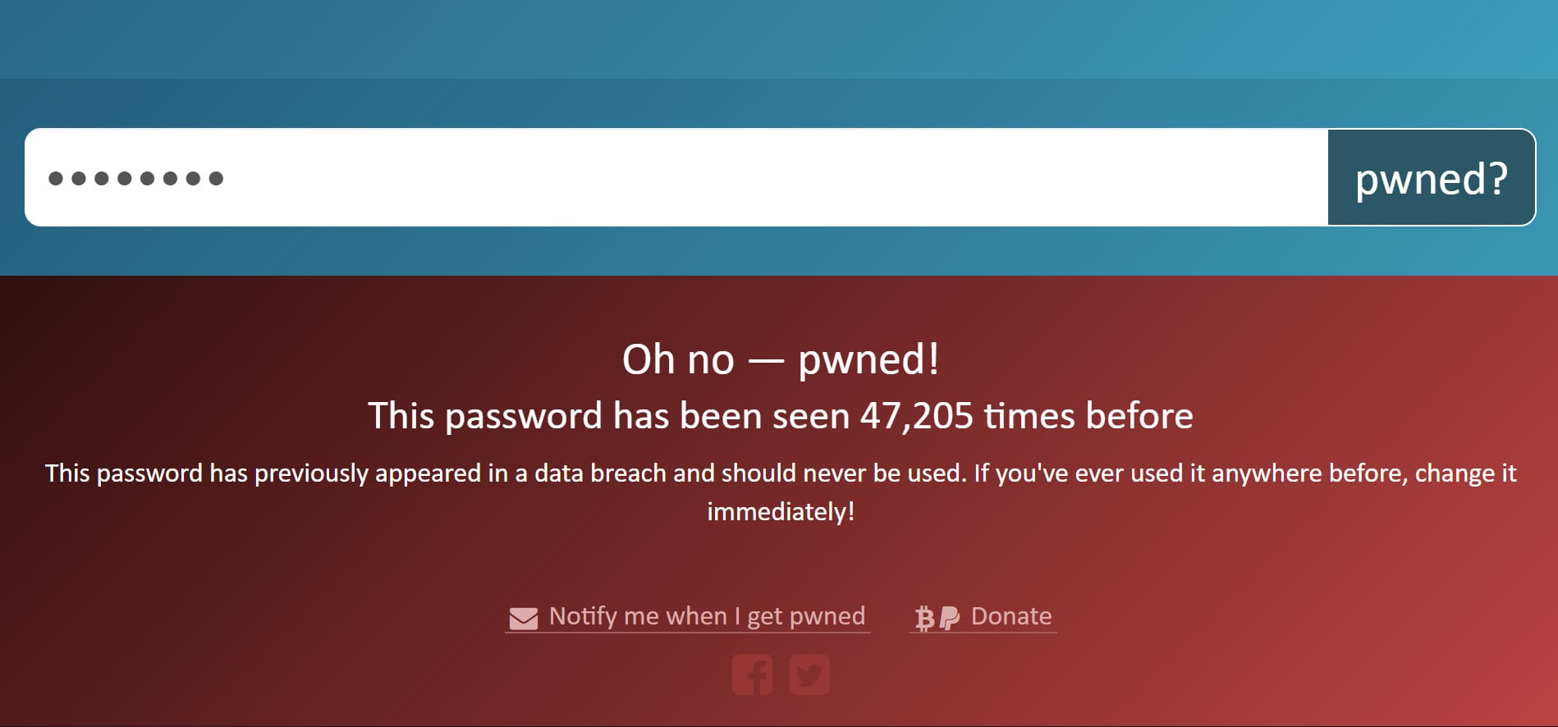
Tools
have i been pwned
Pwned Passwords with k-anonymity
Validating Leaked Passwords with k-Anonymity
Simple implementation

Slide 37
Still need to comply with GDPR
Encrypt the data in transit
Encrypt the data at rest
Encrypt your backups
Protect data integrity
Log access to personal data
Don’t use data for purposes that the user hasn’t agreed with
Don’t log personal data
Many more

Slide 38

You want to use prediction models with user's data

Slide 39
There is a problem...
The diff between the model sent and the model received still leaks private information
By itself, does not guarantee privacy

Slide 40
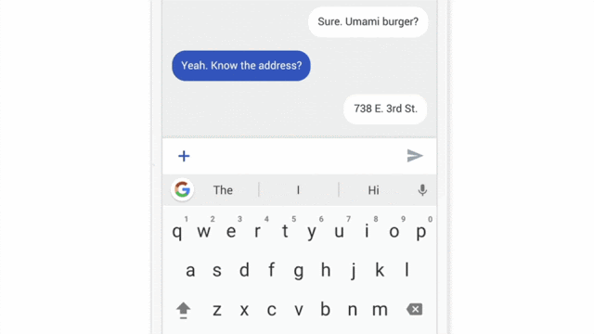

Slide 41
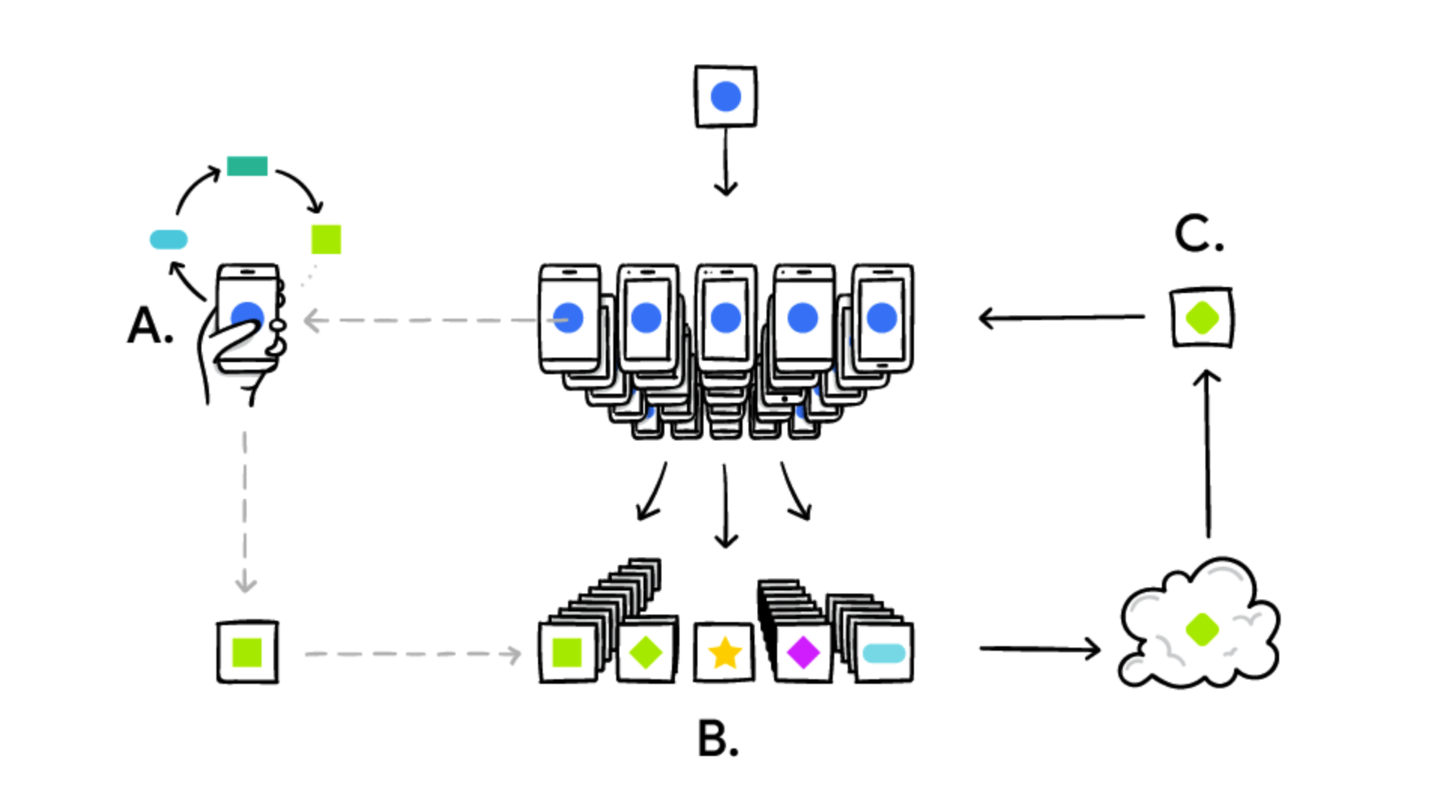
Clients download the current model.
Each client computes an updated model based on their local data.
The model updates are sent to the server.
The server aggregates these models to construct an improved global model

Slide 42
Federated Learning
Enables mobile phones to collaboratively learn a shared prediction model while keeping all the training data on device
No need to store the data in the cloud
Smarter models, lower latency, and less power consumption

Slide 43
Tools
Pytorch
https://github.com/OpenMined/PySyft
Tensorflow
https://github.com/tensorflow/federated
Federated Learning with Pytorch example

Slide 44


You want to update your model with user's data

Slide 45
To share information without the need of a trusted third party to store/process the data. The protocol allows concealing partial information about the data, computing data from many sources without ever revealing individual results

Slide 46
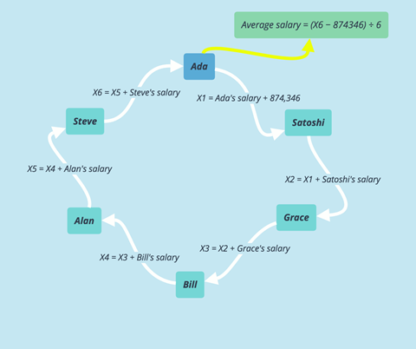
Notes:
https://medium.com/wanchain-foundation/secure-multiparty-computation-and-shamirs-secret-sharing-on-wanchain-e502012b80ef

Slide 47
Secure Multi-Party Computation
Good when a model has multiple owners
Allows for individuals to share control of a model
No party learns any other party’s input
Participants are protected from privacy leakage, except for what can be inferred from the output
Used with other techniques

Slide 48
Tools
Pytorch
https://github.com/OpenMined/PySyft
Tensorflow
https://github.com/tf-encrypted/tf-encrypted
https://github.com/rdragos/awesome-mpc
Implementation of Multi-Party Computation with Pytorch

Slide 49


You want to perform safe operations in sensitive data

Slide 50

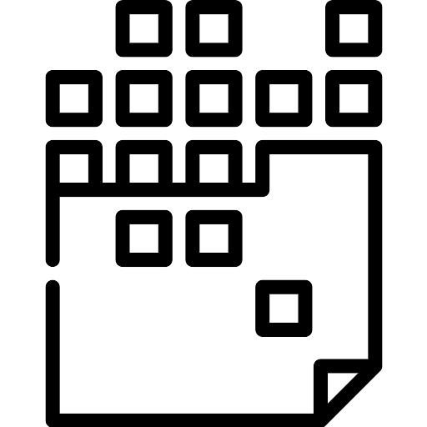
Specific computations are performed in ciphertexts and the obtained result is also a ciphertext that can be revealed only by the owner with a secret key

Slide 51
Specific computations are performed in ciphertexts and the obtained result is also a ciphertext that can be revealed only by the owner with a secret key

Slide 52
Specific computations are performed in ciphertexts and the obtained result is also a ciphertext that can be revealed only by the owner with a secret key

Slide 53
Homomorphic Encryption
Good when a model has a single owner
Data is never unencrypted outside of the users’ environment.
Allows computation on encrypted data.
Secure against quantum computers
Open source implementations
Notes:
https://www.theregister.co.uk/2018/03/08/ibm_faster_homomorphic_encryption/

Slide 54
Homomorphic Encryption
Still a long way from real-world enterprise implementation
Tend to work best when processing integers
Slow. IBM’s initial release ran ‘100 trillion times’ slower than plaintext operations.
Notes:
https://www.theregister.co.uk/2018/03/08/ibm_faster_homomorphic_encryption/

Slide 55
Resume
Randomization: collect sensitive data
k-Anonymity: release dataset
Differential Privacy: aggregate information
Federated Learning: create machine learning models
Secure Multi-Party Computation: distributed processing
Homomorphic encryption: operate over encrypted data
Other things I wish I had the time to mention:
Private Set Intersection
Private Identity Server
Cloak link

Slide 56
Takeaways
If you deal with sensitive data of europeans citizens get a lawyer right now
Data cannot be fully anonymized and remain useful
Queries over large sets are not protective
Summary statistics are Not “Safe”
Remember linkage attacks

Slide 57
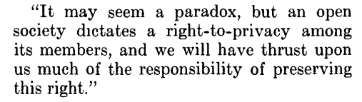

Slide 58




Thank you!
Got any questions?
Rebeca Sarai
Access this talk on vintasoftware.com/talks
Software Engineer
rebeca@vinta.com.br
@_rebecasarai
/rsarai
@_rebecasarai
bit.ly/jane-doe-talk

Slide 59
References
CAO, Jianneng; KARRAS, Panagiotis. Publishing microdata with a robust privacy guarantee. Proceedings of the VLDB Endowment, v. 5, n. 11, p. 1388-1399, 2012.
The Algorithmic Foundations of Differential Privacy (here)
Differentially Private SQL with Bounded User Contribution (here)
Differential Privacy at Scale: Uber and Berkeley Collaboration (video)
Tutorial: Differential Privacy and Learning: The Tools, The Results, and The Frontier (video)
Keeping Your Data Secure While Learning From It - Andreas Dewes and Katharine Jarmul (video)
9 Data Anonymization Use Cases You Need To Know Of (here)
The Definition of Differential Privacy - Cynthia Dwork (video)
Protecting Personal Data with Django (because it's the law) (video)
Pseu, Pseu, Pseudio. Pseudonymization in Django. by Frank Valcarcel (video)
DOMINGO-FERRER, Josep; SORIA-COMAS, Jordi. Anonymization in the time of big data. In: International Conference on Privacy in Statistical Databases. Springer, Cham, 2016. p. 57-68.
LI, Ninghui; LI, Tiancheng; VENKATASUBRAMANIAN, Suresh. t-closeness: Privacy beyond k-anonymity and l-diversity. In: 2007 IEEE 23rd International Conference on Data Engineering. IEEE, 2007. p. 106-115.
SWEENEY, Latanya. k-anonymity: A model for protecting privacy. International Journal of Uncertainty, Fuzziness and Knowledge-Based Systems, v. 10, n. 05, p. 557-570, 2002.
Apple Releases Details on Differential Privacy, and the Big Takeaway Is Which Emoji Is Most Popular (here)
Differential Privacy In Action (here)

